Slide 1
Edge Vision: Intelligent Surveillance with
Instant Threat Detection
PRASANNA M U
Department of Information Technology
Meenakshi College of Engineering, Chennai
prachuparamount@gmail.com

Slide 2
Research Context & Abstract
The Problem Statement
• Current physical surveillance systems rely heavily on manual monitoring.
• Existing AI tools in the market are often used in inefficient way.
Research Summary
Integration of face detection, face recognition, and AI features into a real-time web application to automate threat identification and security analytics.

Slide 3
What's Included: Key Features
Real-Time Web Application
A centralized dashboard for instantaneous data monitoring.
Edge AI Prototype
Processing data at the source to ensure low latency and high efficiency.
Advanced Biometrics
Precision face detection and recognition using state-of-the-art libraries.
Security First
Robust authentication and authorization protocols to protect sensitive data.

Slide 4
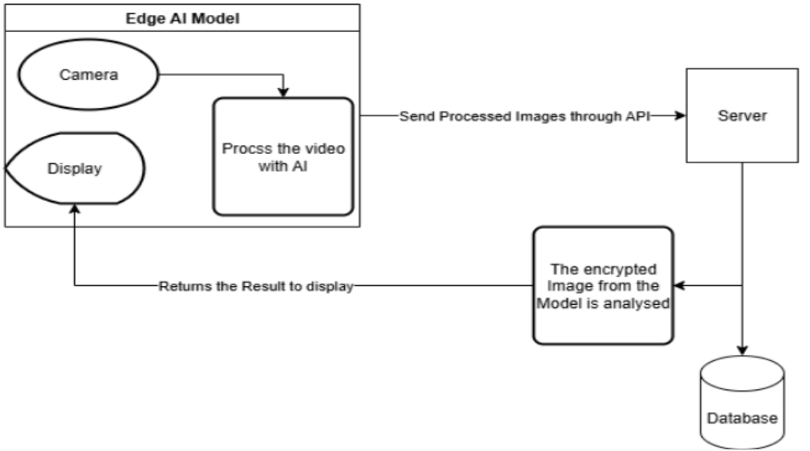
Proposed Methodology
Real-Time Dashboard Architecture
• Seamless connection to camera modules via RESTful APIs.
• Multi-tier login system to ensure data barrier protection.
• automation to suppress the need for excessive manpower.
• Direct correlation between automation and reduced operational costs.
Automation Efficiency
High Efficiency =
Low Manpower + Low Cost

Slide 5
Technical Stack & Tools
Frameworks
Django REST Framework (API), Django Templates (UI)
Computer Vision
OpenCV, Dlib for Face Recognition
AI Models
YOLO Models for Object Detection(Future Enhancement)
Processing
Image Processing Tools, ASYNC Integration
Deployment
Cloud Service

Slide 6
Operational Use Cases
Case 1: Civil Security
Officer registry updates and instant 'Wanted Person' alerts relayed to control rooms.
Case 2: Remote Areas
Monitoring entry/exit in forest or mountain regions to identify missing persons and track movement.
Case 3: Static Premises
Centrally mounted AI cameras (45° angle) providing 100% automated monitoring of commercial premises.

Slide 7
Security & Data Protection
🛡️ Multi-tier Login & Role-based Permissions
🛡️ Email Authentication & Supreme User Auth
🛡️ Sha256 Encrypted Passwords
🛡️ Token-based API Security
🛡️ Encrypted Communication & Data Sanitization
🛡️Usage of RESTful API

Slide 8
Target Audience & Market Demand
Target Segments:
• Law Enforcement & Police Officers
• Defense Research (DRDO) & Government Agencies
• Large-scale Commercial Spaces (Malls, Hubs)
Market Gap:
Current dependence on inefficient manual manpower is costly. Our Edge AI solution transitions from labor-heavy to technology-driven security, ensuring higher profitability and precision.

Slide 9
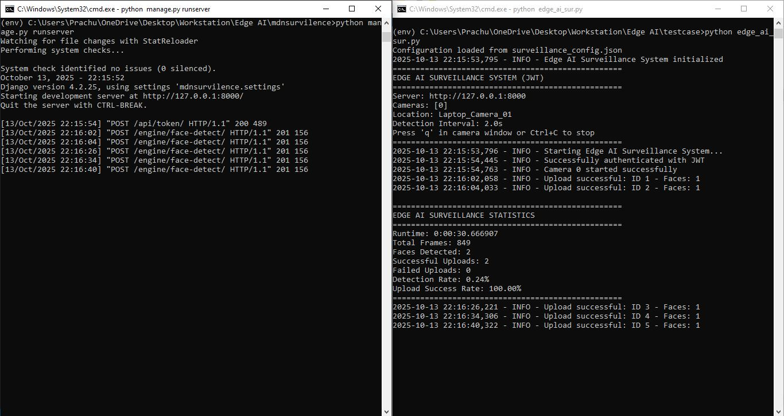
Results and Conclusion
TRL 4+ Alignment:
• Executed in controlled lab environments and made the precedence for TRL 5.
• Validated reliability in simulated field conditions.
Final Conclusion
Ensures civilian safety by controlling entry/exit and reducing risks through a reliable Edge-AI ecosystem. Future versions will be fine-tuned to meet specific commercial market demands.

Slide 10
THANK YOU
Thanks for your patience in observing this presentation.
Contact Details:
Prasanna M U
prasannaprachu1@gmail.com

